Slide 1
RideEase
Car Pooling Application
TEAM 2:
Himanshu Garg | Manas Karande | Abhyaung Havale | Manjusha Domala | Abhay Soni | Abhishek Kasula | Karan Yadav | Shivam Dubey | Shivani Jain | Anish Ayare

Slide 2
Agenda
GitHub
Repo structure | Prerequisites | Installation
Code Snippets
Frontend | Backend
Deployment
Jenkins

Slide 3
Github URL:
https://github.com/himanshu8655/rideease-backend

Slide 4
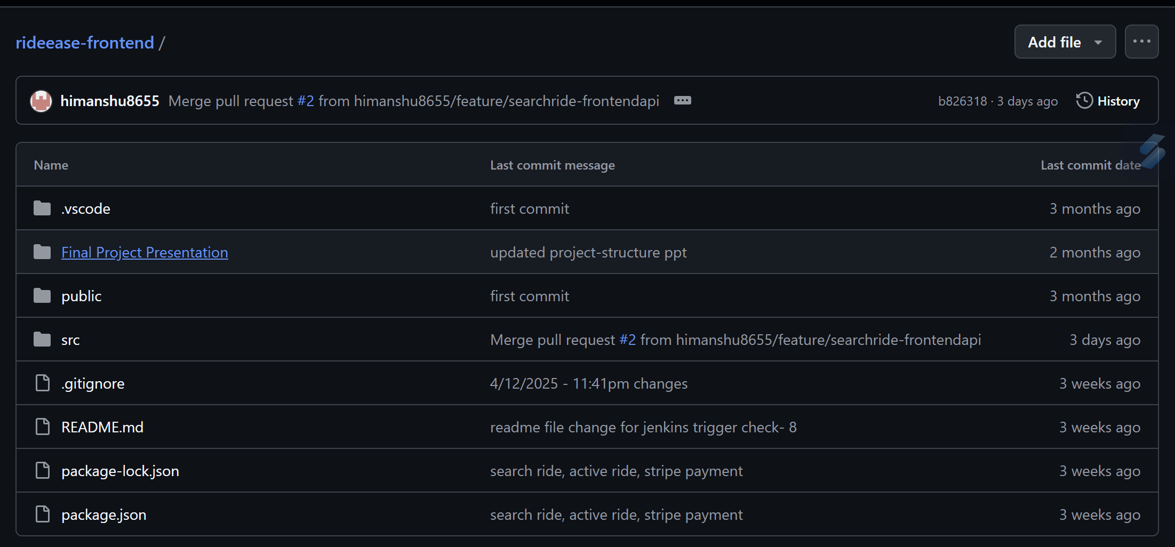
Repo Structure (Final Presentation)

Slide 5
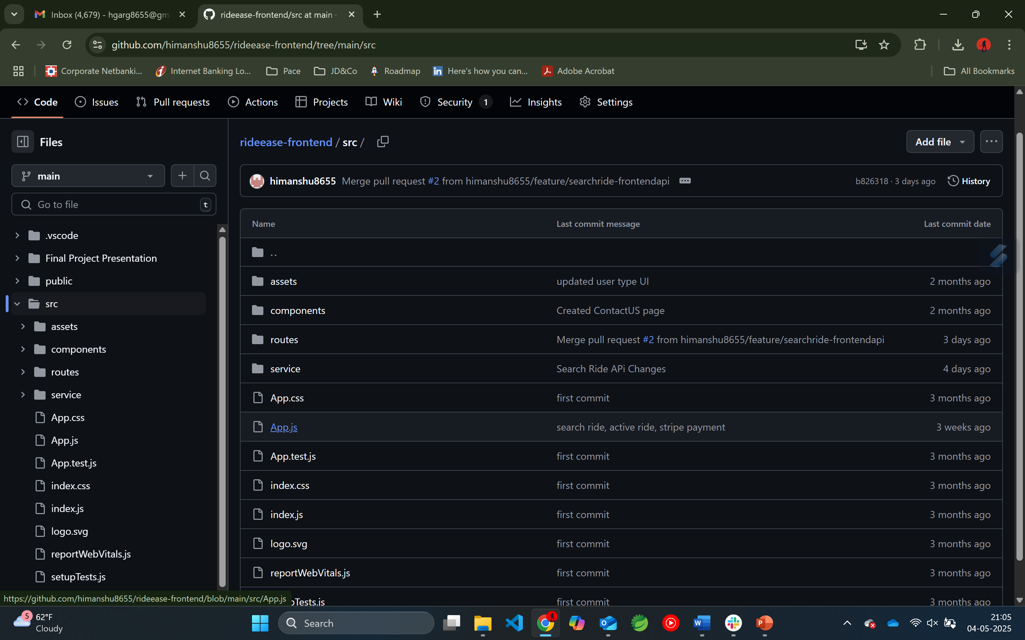
Repo Structure (Client - Frontend)

Slide 6
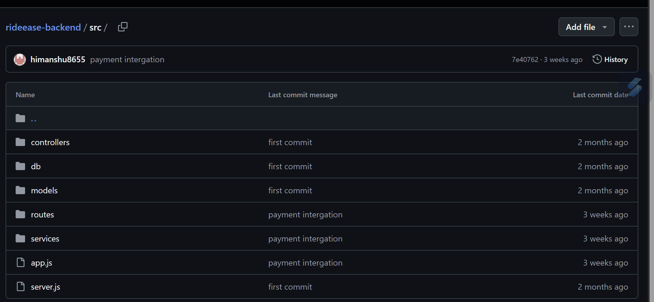
Repo Structure (Server - Backend)

Slide 7
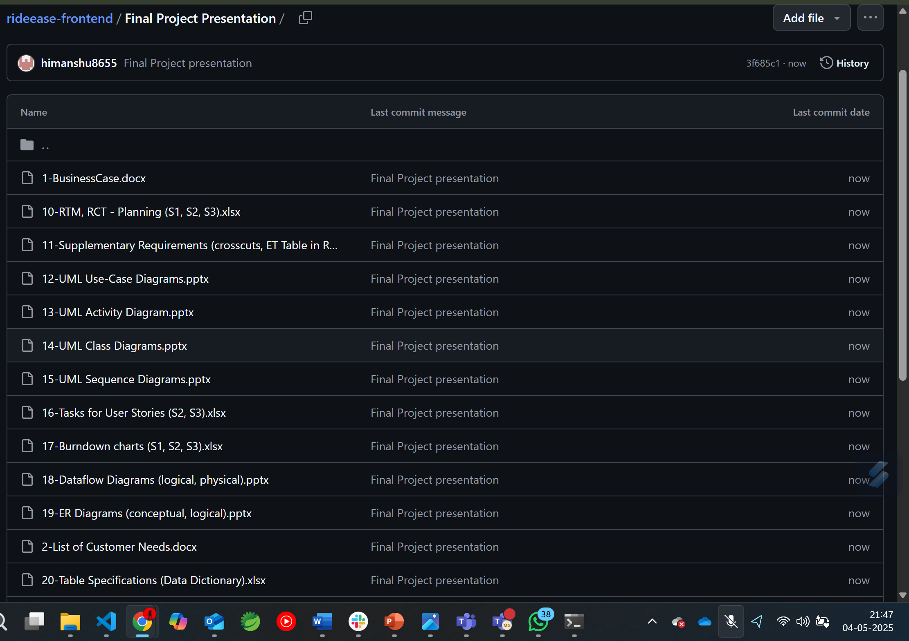
Repo Structure (Final Deliverables)

Slide 8




Prerequisite
MongoDB (Atlas)
Google API key, Stripe Payment
IDEs for Frontend and Backend
React.js, Express.js, Node.js, npm

Slide 9

Code Snippets

Slide 10
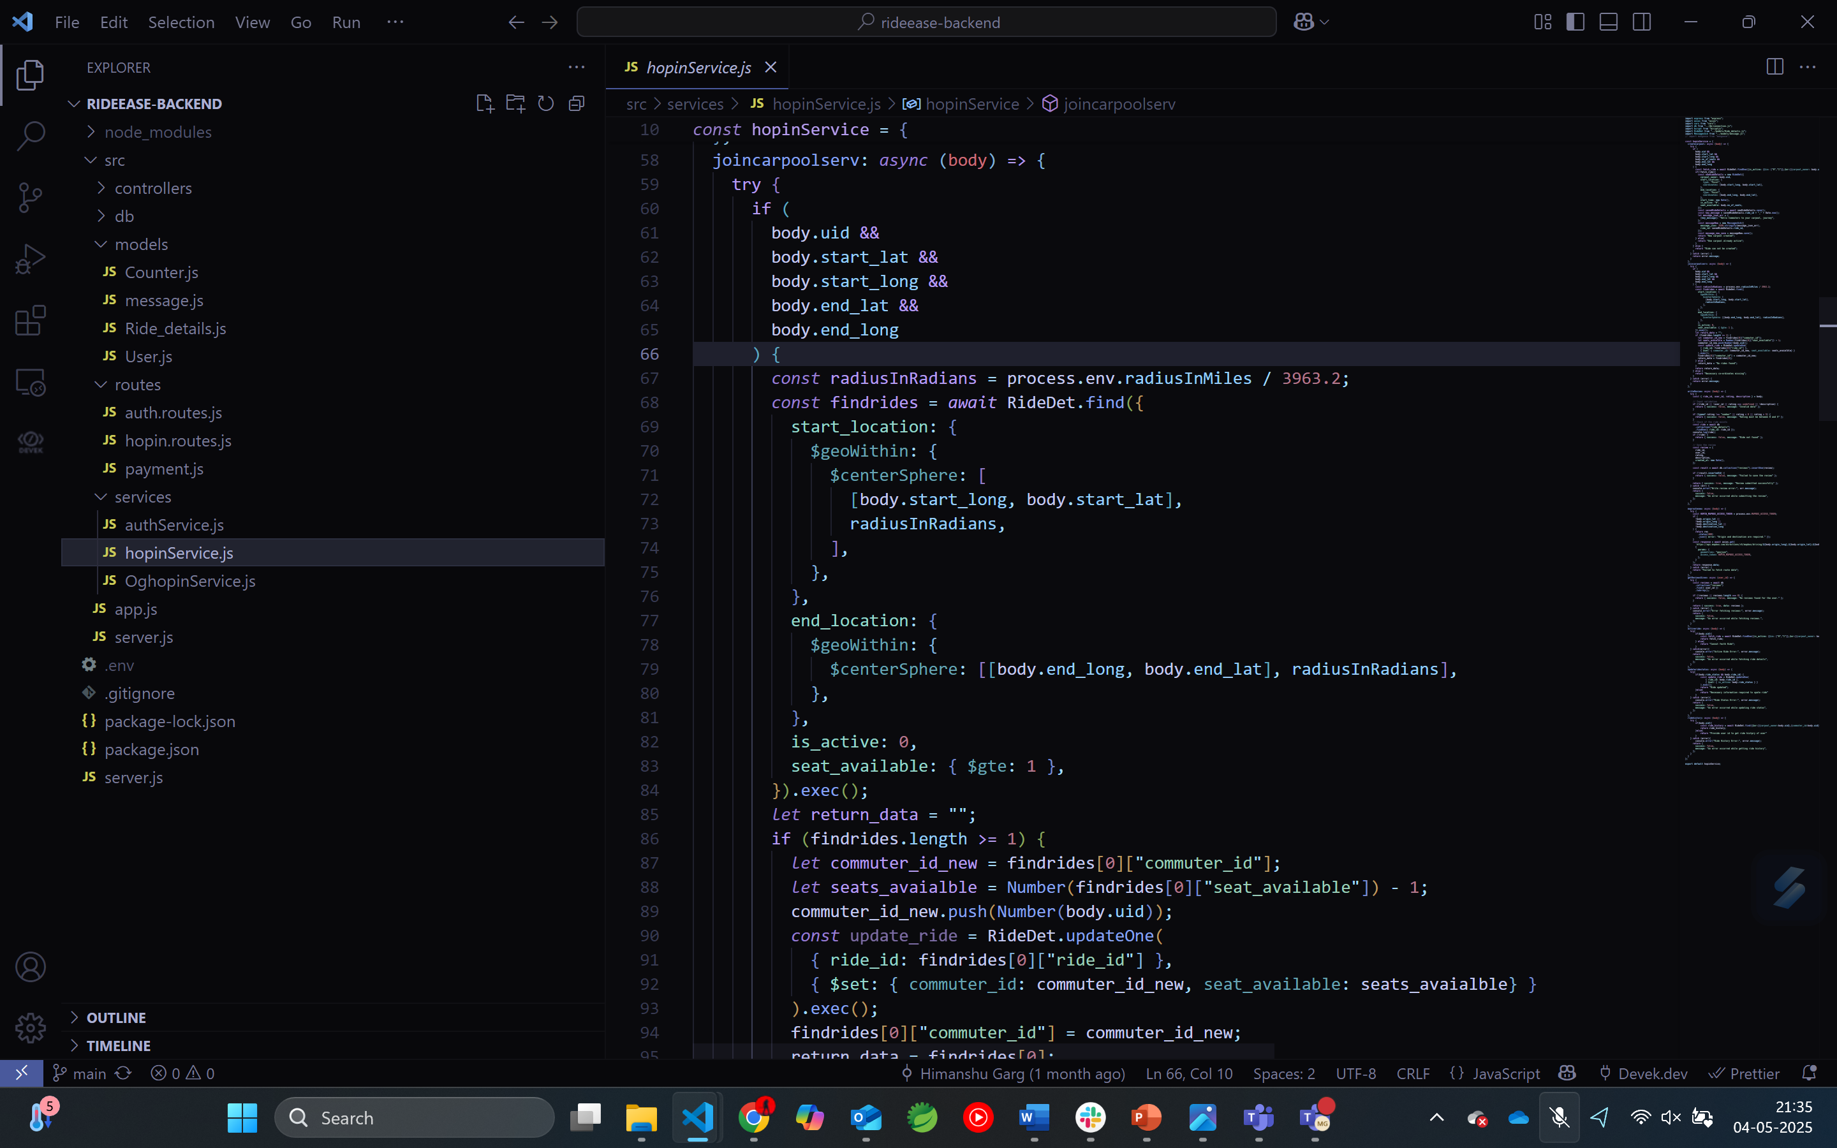
Search Ride (Backend)

Slide 11
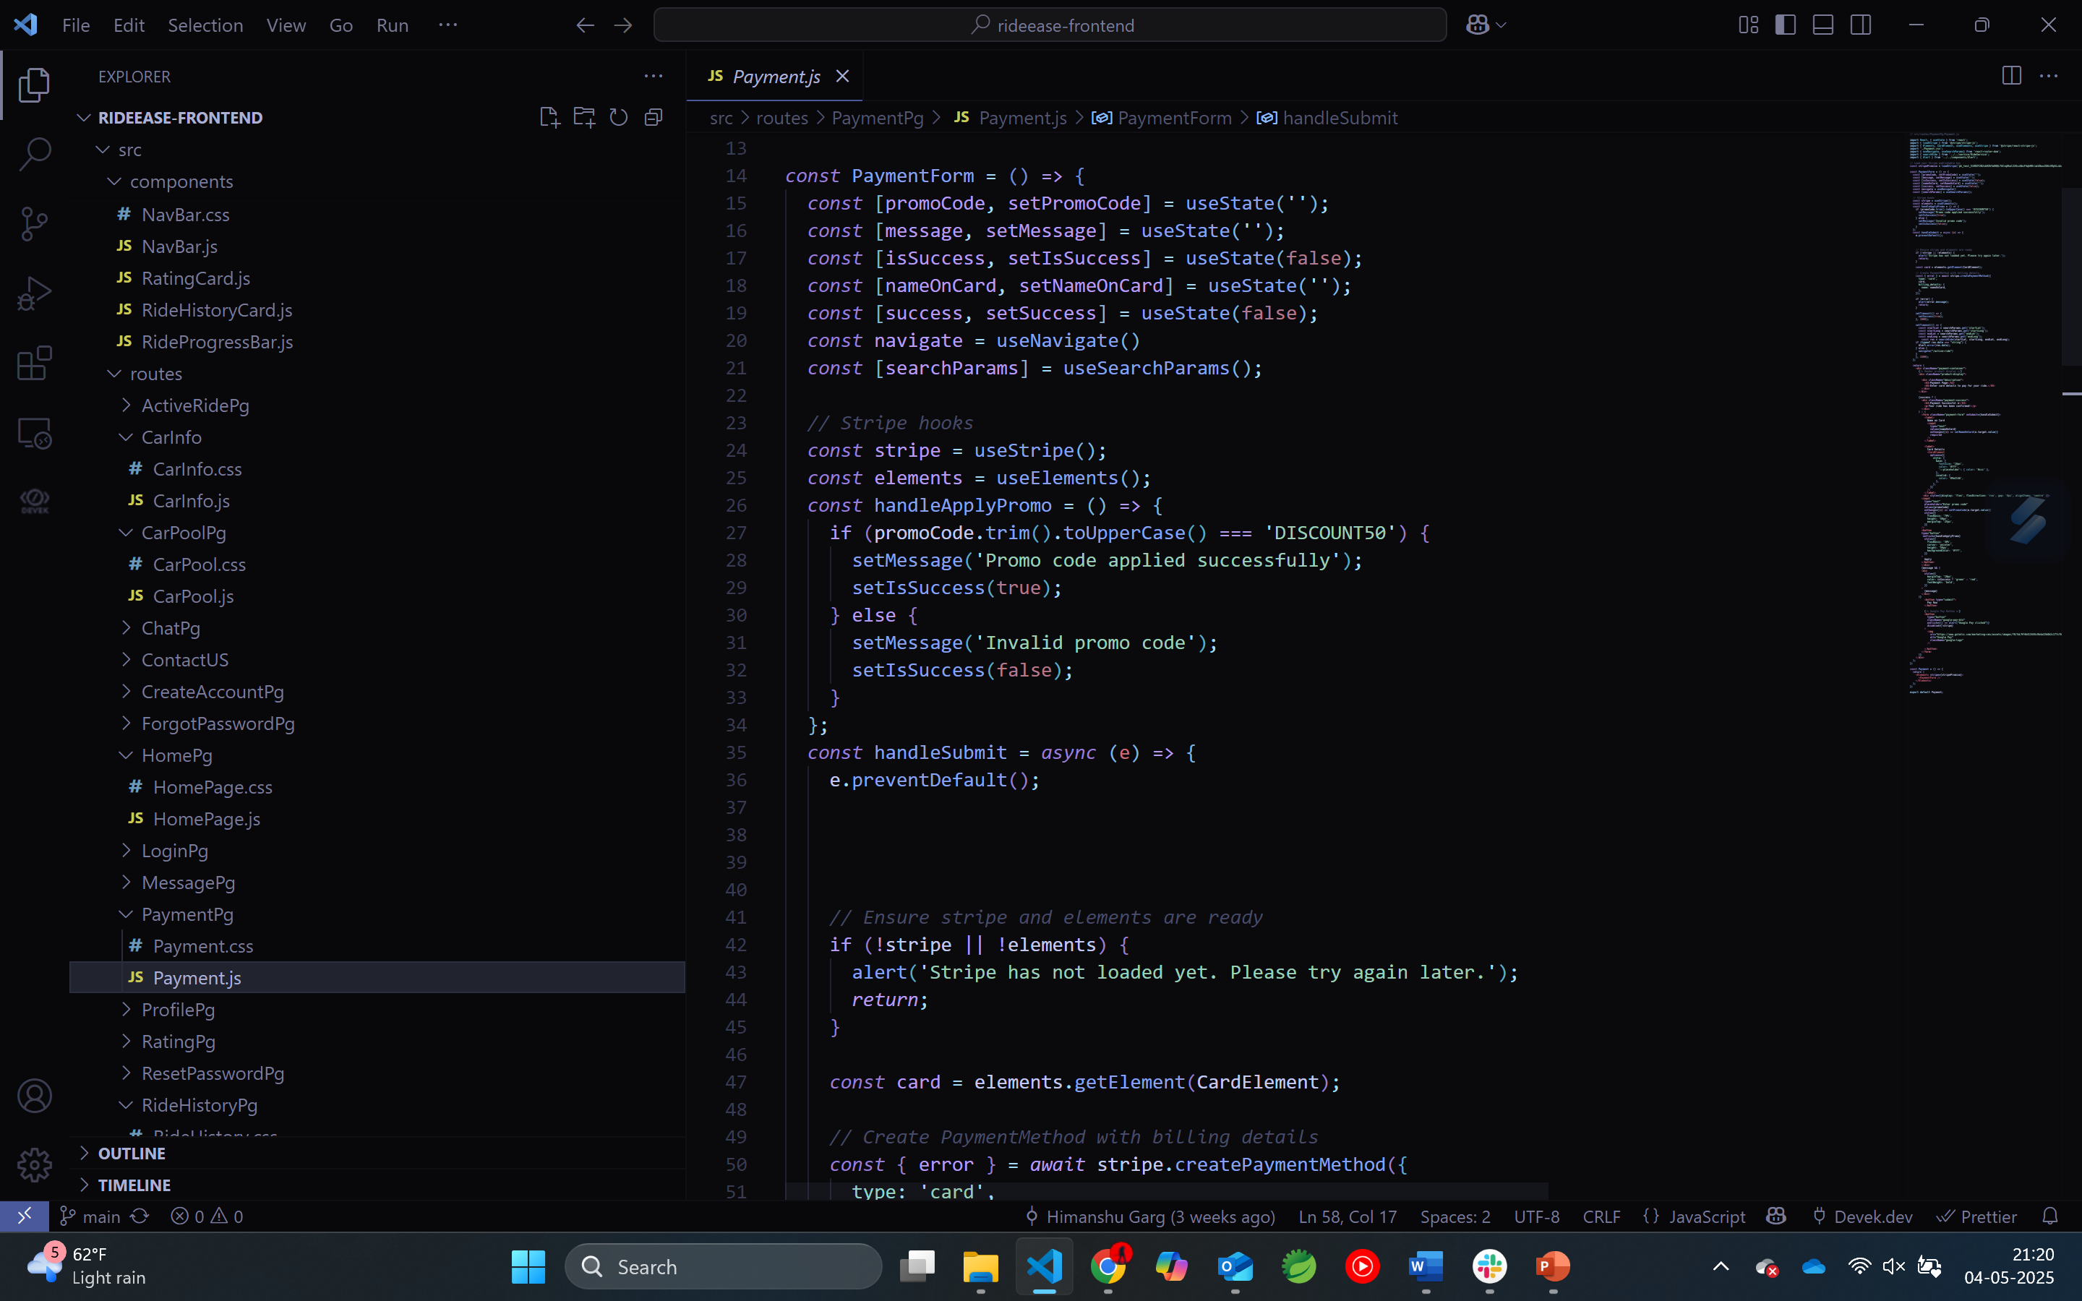
Stripe Payment (Frontend)

Slide 12
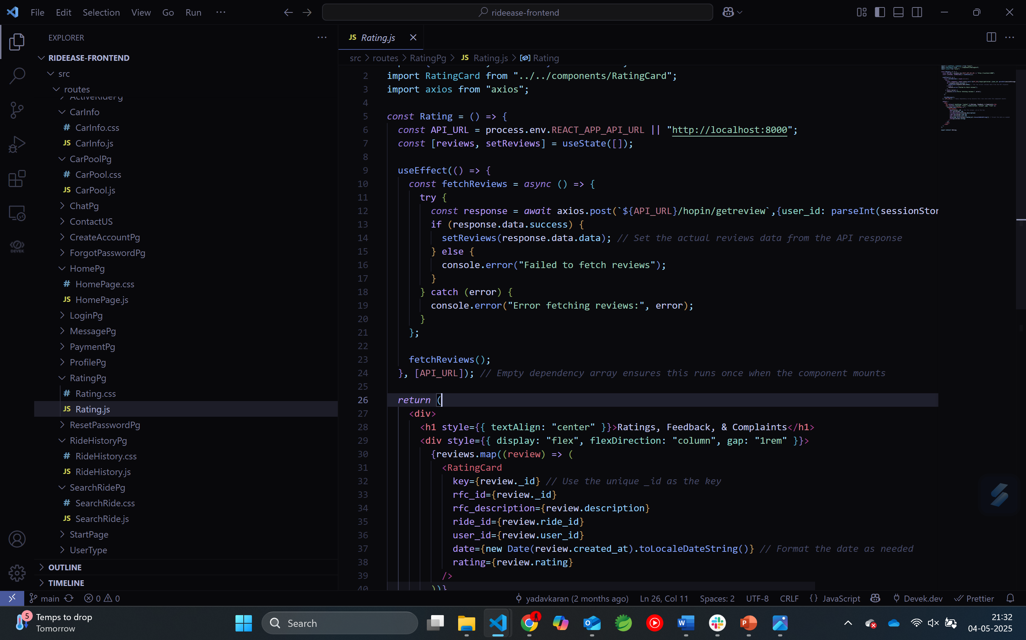
Reviews (Vehicle Reviews-Frontend)

Slide 13
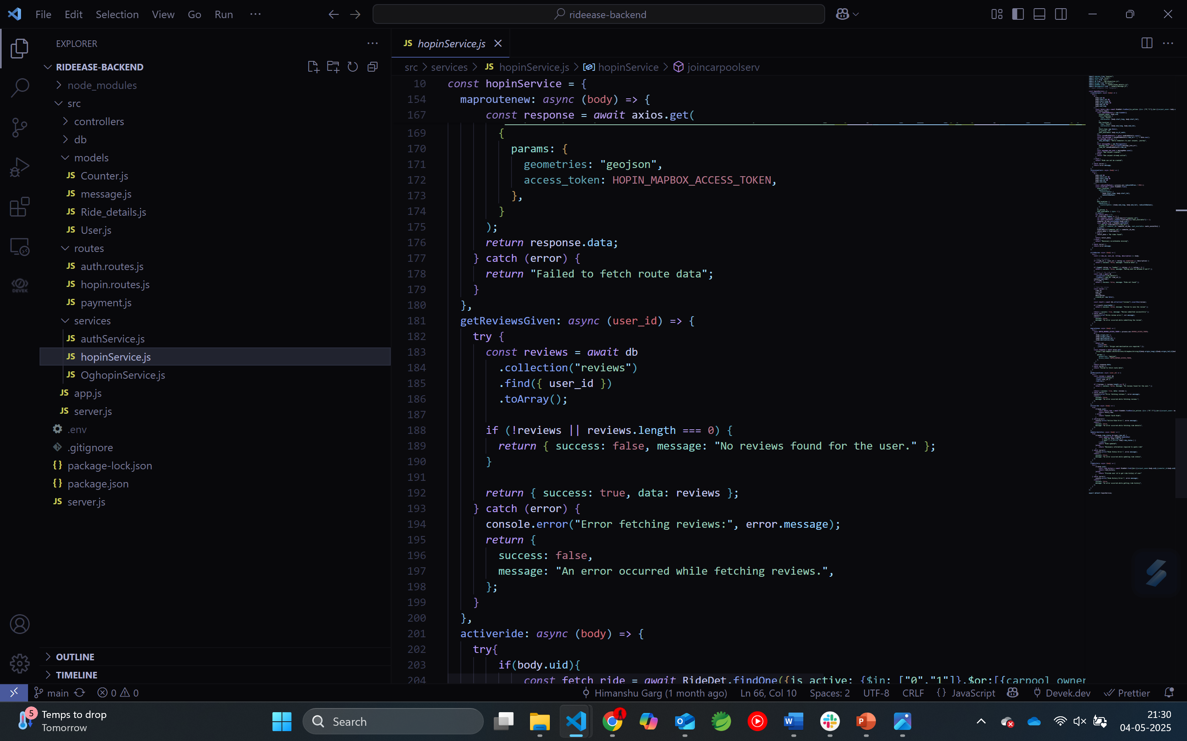
Reviews (Ride Reviews-Backend)

Slide 14
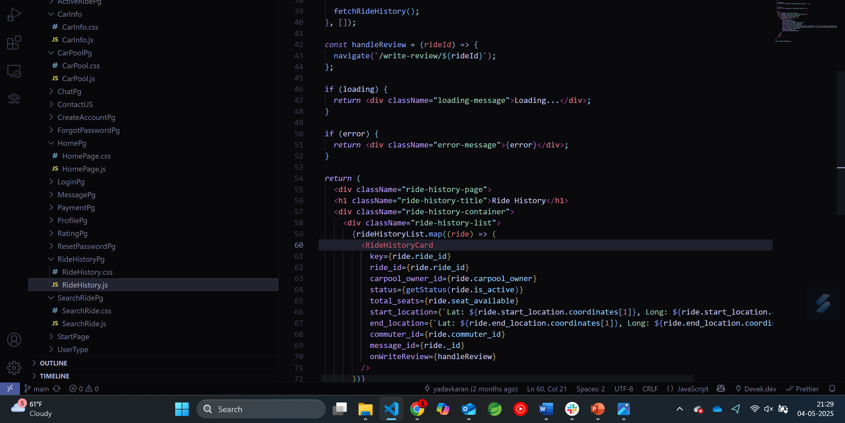
Ride History (Ride History-Frontend)

Slide 15
Deployment

Slide 16
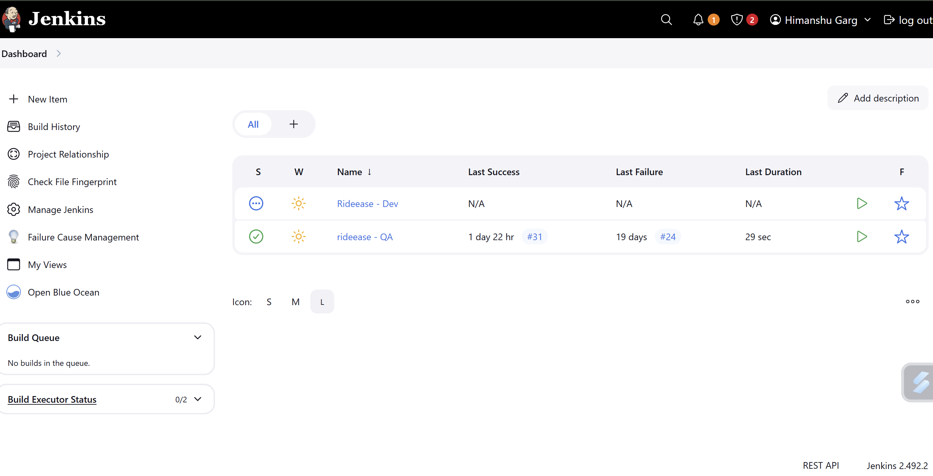
Jenkins Dashboard

Slide 17
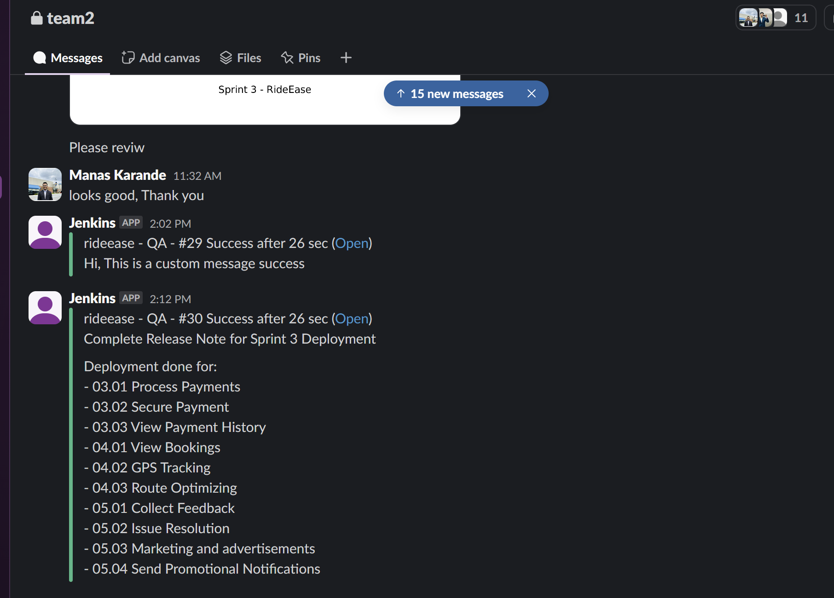
Slack Notification

Slide 18
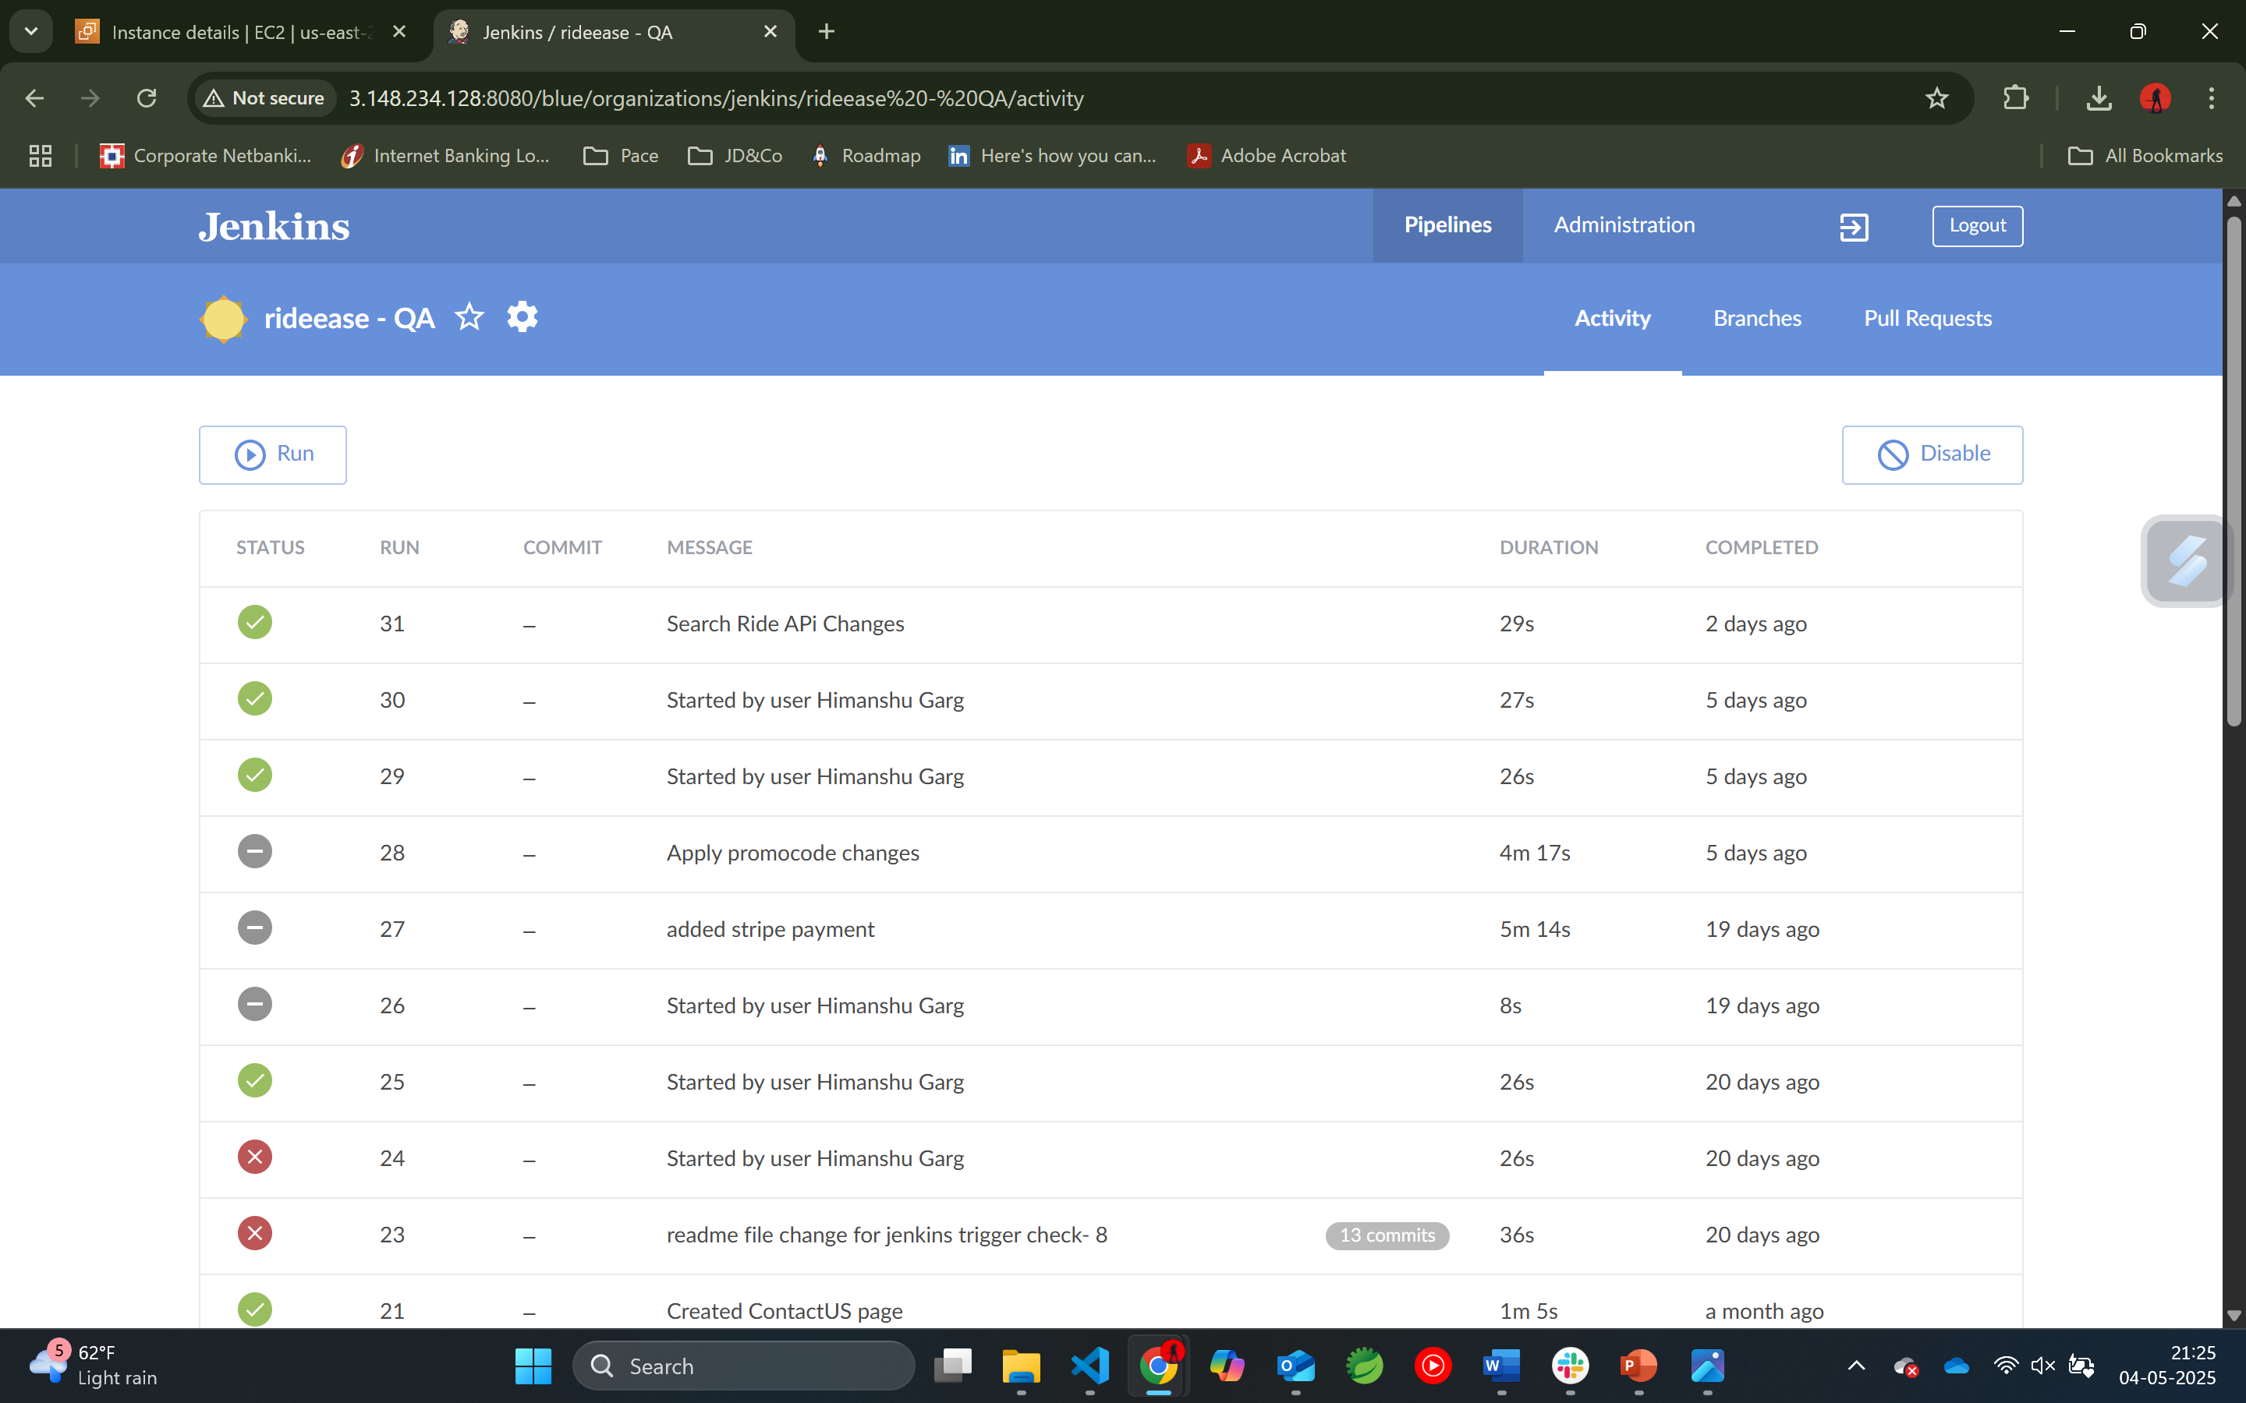
Blue Ocean Plugin

Slide 19
THANK YOU !

